Slide 1
Introduction to Programming
Spring 2022

Slide 2
Objects and Graphics
Overview
The Object of Objects
Simple Graphics Programming
Using Graphical Objects
Interactive Graphics
Graphics Module Reference
CSCI 1410
Dr. Salim Lakhani
/

Slide 3
Using Graphical Objects
Computation is performed by asking an object to carry out one of its operations (by sending messages)
In the previous example we manipulated GraphWin, Point, Circle, Oval, Line, Text and Rectangle.
  These are examples of classes.
CSCI 1410
Dr. Salim Lakhani
/

Slide 4
Using Graphical Objects
Each object is an instance of some class, and the class describes the properties of the instance.
Examples
Class | Objects (Instances)
Car | my_red_car, my_ford_mustang
Student | student_1, student_2
Point | p1, p2
CSCI 1410
Dr. Salim Lakhani
/
Notes:
Note:
Class name will always start with upper case letter
Instance name will start with lower case letter
and words are separeted with underscore (_)
Can also use camel casing

Slide 5
Using Graphical Objects
To create a new instance of a class, we use a special operation called a constructor.
class-name(<param1>, <param2>, …)
class-name is the name of the class we want to create a new instance of, e.g. Circle or Point.
The parameters are required to initialize the object. For example, Point requires two numeric values.
A class can have multiple constructors
Example
CSCI 1410
Dr. Salim Lakhani
/
Notes:
GraphWin (title, width, height)
GraphWin
GraphWin (‘My Window’)
GraphWin (‘My Window’, 400)
GraphWin (‘My Window’, 400, 400)

Slide 6
Using Graphical Objects
Example
  p = Point (50, 60)
  The constructor for the point requires two parameters, the x and y coordinates for the point
  These values are stored as instance variables inside of the object
CSCI 1410
Dr. Salim Lakhani
/

Slide 7
Using Graphical Objects
Example:
  x = 45
  y = 12.56
  p = Point (50, 60)
CSCI 1410
Dr. Salim Lakhani
/
Notes:
x
45
y
12.56
Point
50
60
p

Slide 8
Using Graphical Objects
To perform an operation on an object, we send the object a message. The set of messages an object responds to are called the methods of the object.
Methods are like functions that live inside the object.
Methods are invoked using dot-notation:
object_name.method_name
(<param1>, <param2>, …)
Parameter are the data that you want to pass to the method
CSCI 1410
Dr. Salim Lakhani
/

Slide 9
Using Graphical Objects
p.getX() and p.getY() returns the x and y values of the point.
Provides information about an instance of the class
Example
Methods like these are referred to as accessors because they allow us to access information from the instance variables of the object.
CSCI 1410
Dr. Salim Lakhani
/
Notes:
p1 = point (50, 60)
p2 = point (23, 45)
p1.getX(), p1.getY(), p2.getX(), p2.getY()

Slide 10
Using Graphical Objects
Other methods change the state of the object by changing the values of the object’s instance variables.
move(dx, dy) moves the object dx units in the x direction and dy in the y direction.
Move erases the old image and draws it in its new position. Methods that change the state of an object are called mutators.
Example
CSCI 1410
Dr. Salim Lakhani
/
Notes:
Must use with instance name
p1.move (10, 12)
p2.move (10, 10)

Slide 11
Using Graphical Objects
It’s possible for two different variables to refer to the same object – changes made to the object through one variable will be visible to the other.
leftEye = Circle(Point(80,50), 5)
leftEye.setFill('yellow')
leftEye.setOutline('red')
rightEye = leftEye
rightEye.move(20,0)
The idea is to create the left eye and copy that to the right eye which gets moved over 20 units.
CSCI 1410
Dr. Salim Lakhani
/

Slide 12
Using Graphical Objects
The assignment
rightEye = leftEye
makes rightEye and leftEye refer to the same circle!
The situation where two variables refer to the same object is called aliasing.
CSCI 1410
Dr. Salim Lakhani
/

Slide 13
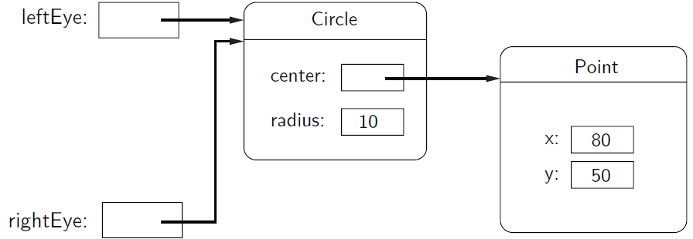
Using Graphical Objects
CSCI 1410
Dr. Salim Lakhani
/

Slide 14
Using Graphical Objects
There are two ways to get around this.
We could make two separate circles, one for each eye:
leftEye = Circle(Point(80, 50), 5)
leftEye.setFill('yellow')
leftEye.setOutline('red')
rightEye = Circle(Point(100, 50), 5)
rightEye.setFill('yellow')
rightEye.setOutline('red')
CSCI 1410
Dr. Salim Lakhani
/

Slide 15
Using Graphical Objects
The graphics library has a better solution. Graphical objects have a clone method that will make a copy of the object!
leftEye = Circle(Point(80, 50), 5)
leftEye.setFill('yellow')
leftEye.setOutline('red')
rightEye = leftEye.clone()
rightEye.move(20, 0)
CSCI 1410
Dr. Salim Lakhani
/

Slide 16
Handling Textual Input
The GraphWin object provides a getKey() method that works like the getMouse method.
CSCI 1410
Dr. Salim Lakhani
/

Slide 17
Handling Textual Input
There’s also an Entry object that can get keyboard input.
The Entry object draws a box on the screen that can contain text. It understands setText and getText, with one difference that the input can be edited.
CSCI 1410
Dr. Salim Lakhani
/

Slide 18
Handling Textual Input
CSCI 1410
Dr. Salim Lakhani
/

Slide 19
Class Work
Describe in your own words the objects produced by each of the following operations:
1) Point (130, 130)
2)c = Circle (Point (30, 40), 25)
c.setFill (‘blue’)
c.setOutline (‘red’)
3) r = Rectangle (Point (20, 20),
Point (40, 40))
r.setFill (color_rgb(0, 255, 150))
r.setWidth (3)
CSCI 1410
Dr. Salim Lakhani
/

Slide 20
Class Work
4) l = Line (Point (100, 100),
Point (100, 200)
l.setOutline (‘red’)
l.setArrow(‘first’)
5) Oval (Point (50, 50),
Point (60, 100))
6) shape = Polygon (Point (5, 5), Point (10, 10), Point (5, 10), point (10, 5))
shape.setFill (‘Orange’)
CSCI 1410
Dr. Salim Lakhani
/

